Slide 1
Introduction to Software Engineering
Agile Software Development(3)
Muhammad Nasir
m.nasir@iiu.edu.pk

Slide 2
Agenda
SCRUM
  Sprint
  Back Log
  SCRUM Meetings
  Demos

Slide 3
SCRUM
Scrum (*the name is derived from an activity that occurs during a rugby match) is an agile software development method
Conceived by Jeff Sutherland and his development team in the early 1990
* A group of players forms around the ball and the teammates work together (sometimes violently!) to move the ball downfield

Slide 4
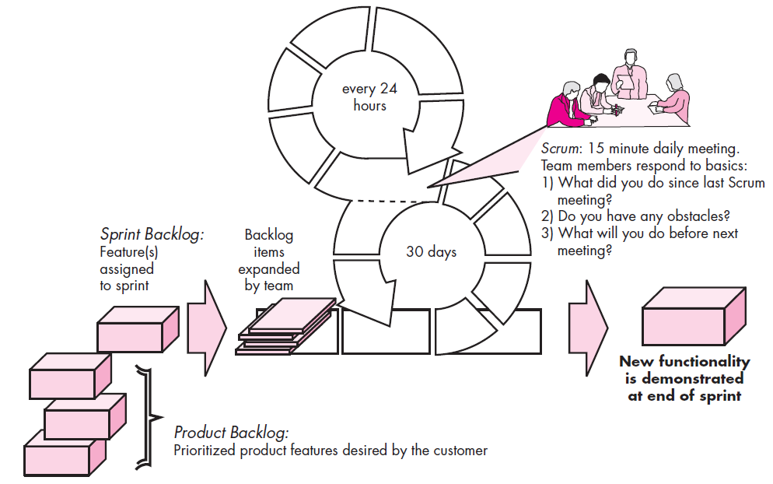
SCRUM

Slide 5
SCRUM
Scrum principles are consistent with the agile manifesto and are used to guide
Development activities within a process that incorporates the following framework activities: requirements, analysis, design, evolution, and delivery.

Slide 6
SCRUM
Within each framework activity, work tasks occur within a process pattern called a sprint.
The number of sprints required for each framework activity will vary depending on product complexity and size

Slide 7
SCRUM
The work conducted within a sprint is adapted to the problem at hand and is defined and often modified in real time by the Scrum team.

Slide 8
SCRUM
Scrum emphasizes the use of a set of software process patterns that have proven effective for projects with tight timelines, changing requirements
  Back Log
  Sprints
  Scrum Meetings
  Demos

Slide 9
Back Log
A prioritized list of project requirements or features that provide business value for the customer.
Items can be added to the backlog at any time (this is how changes are introduced).
The product manager assesses the backlog and updates priorities as required

Slide 10
Sprints
Sprints—consist of work units that are required to achieve a requirement defined in the backlog that must be fit into a predefined time-box (typically 30 days)
A time-box is a project management term that indicates a period of time that has been allocated to accomplish some task.

Slide 11
Scrum Meetings
Scrum meetings—are short (typically 15 minutes) meetings held daily by the Scrum team.
Three key questions are asked and answered by all team members:
  What did you do since the last team meeting?
  What obstacles are you encountering?
  What do you plan to accomplish by the next team meeting?

Slide 12
Scrum Meetings
A team leader, called a Scrum master, leads the meeting and assesses the responses from each person.
The Scrum meeting helps the team to uncover potential problems as early as possible.
Also, these daily meetings lead to “knowledge socialization” and thereby promote a self-organizing team structure.

Slide 13
Demos
Demos—deliver the software increment to the customer so that functionality that has been implemented can be demonstrated and evaluated by the customer.

Slide 14
Demos
It is important to note that the demo may not contain all planned functionality, but rather those functions that can be delivered within the time-box that was established.

Slide 15
The End
Thanks for listening
Questions would be appreciated.

